Slide 1
LECTURE 02
The Project Management and Information Technology Context

Slide 2
Learning Objectives
Describe the systems view of project management and how it applies to information technology (IT) projects
Understand organizations, including the four frames, organizational structures, and organizational culture
Explain why stakeholder management and top management commitment are critical for a project’s success

Slide 3
Learning Objectives
Understand the concept of a project phase and the project life cycle, and distinguish between project development and product development
Discuss the unique attributes and diverse nature of IT projects
Describe recent trends affecting IT project management, including globalization, outsourcing, virtual teams, and agile project management

Slide 4
Projects Cannot Be Run In Isolation
Projects must operate in a broad organizational environment
Project managers need to use systems thinking:
taking a holistic view of carrying out projects within the context of the organization
Senior managers must make sure projects continue to support current business needs

Slide 5
A Systems View of PM
A systems approach emerged in the 1950s to describe a more analytical approach to management and problem solving
Three parts include:
Systems philosophy: an overall model for thinking about things as systems
Systems analysis: problem-solving approach
Systems management: address business, technological, and organizational issues before making changes to systems

Slide 6
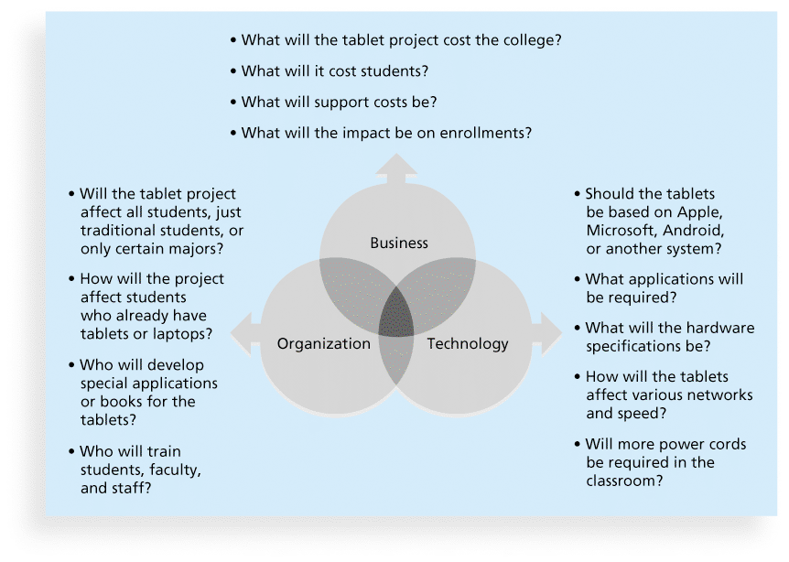
Figure 2-1. Three Sphere Model for Systems Management

Slide 7
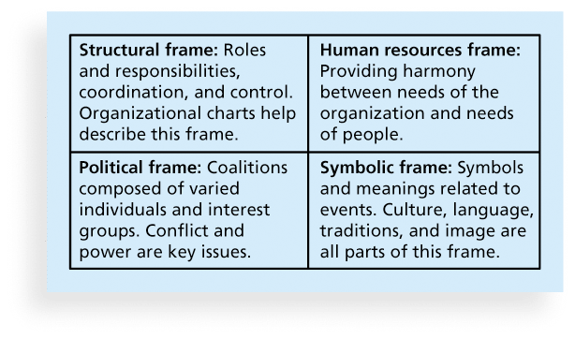
Figure 2-2. Perspectives on Organizations

Slide 8
What Went Wrong?
In a paper titled “A Study in Project Failure,” two researchers examined the success and failure of 214 IT projects over an eight-year period in several European countries.
12.5% were considered successful in terms of meeting scope, time, and cost goals.
Findings - Culture within many organizations is often to blame
Among other things, people often do not discuss important leadership, stakeholder, and risk management issues

Slide 9
Organizational Structures
3 basic organization structures
Functional: functional managers report to the CEO
Project: program managers report to the CEO
Matrix: middle ground between functional and project structures; personnel often report to two or more bosses; structure can be weak, balanced, or strong matrix

Slide 10
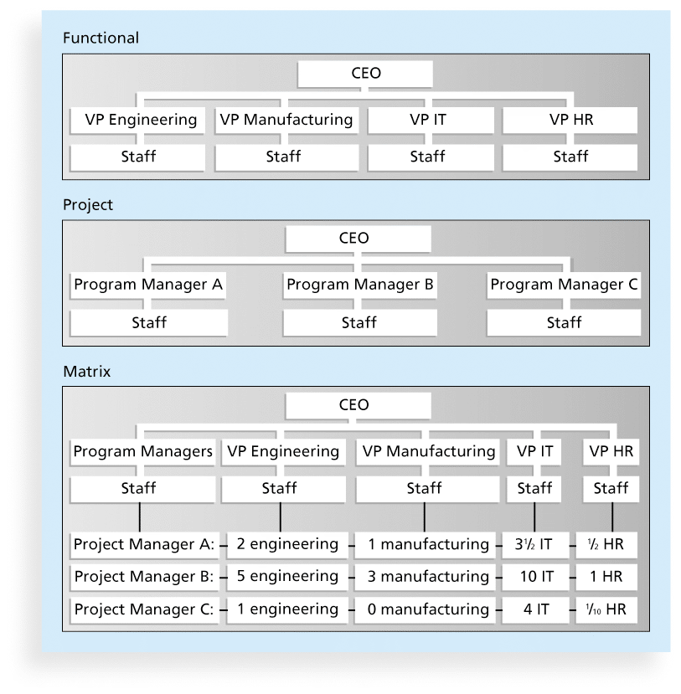
Figure 2-3. Functional, Project & Matrix Organizational Structures

Slide 11
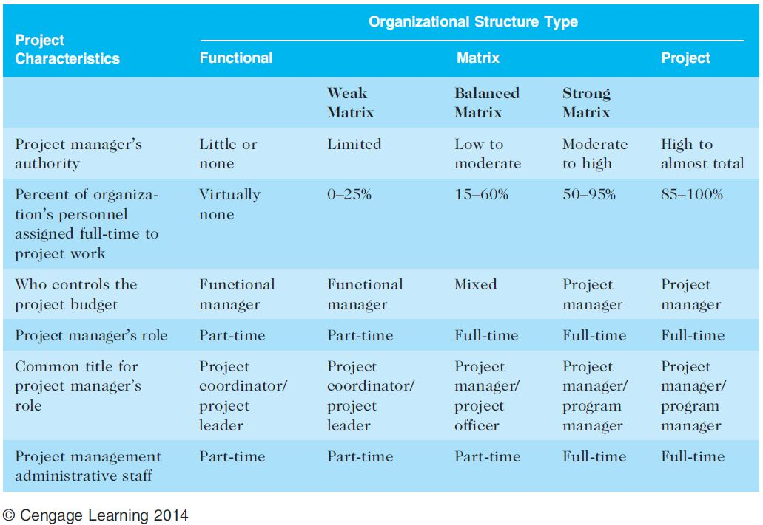
Table 2-1. Organizational Structure Influences on Projects

Slide 12
Organizational Culture
Organizational culture is a set of shared assumptions, values, and behaviors that characterize the functioning of an organization
Many experts believe the underlying causes of many companies’ problems are not the structure or staff, but the culture

Slide 13
10 Characteristics of Organizational Culture
Member identity*
Group emphasis*
People focus
Unit integration*
Control
Risk tolerance*
Reward criteria*
Conflict tolerance*
Means-ends orientation
Open-systems focus*
*Project work is most successful in an organizational culture where these items are strong/high and other items are balanced

Slide 14
The Importance of Top Management Commitment
People in top management positions are key stakeholders in projects
Level of commitment and support received from top management ensures success
Without top management commitment, many projects will fail
Some projects have a senior manager called a champion who acts as a key proponent for a project

Slide 15
How Top Management can Help PMs
Providing adequate resources
Approving unique project needs in a timely manner
Getting cooperation from other parts of the organization
Mentoring and coaching on leadership issues

Slide 16
Need for Organizational Commitment to IT
If the organization has a negative attitude toward IT, it will be difficult for an IT project to succeed
Having a Chief Information Officer (CIO) at a high level in the organization helps IT projects
Assigning non-IT people to IT projects also encourage more commitment

Slide 17
Need for Organizational Standards
Standards and guidelines help project managers be more effective
Senior management can encourage
the use of standard forms and software for project management
the development and use of guidelines for writing project plans or providing status information
the creation of a project management office or center of excellence

Slide 18
Project Phases & the Project Life Cycle
A project life cycle is a collection of project phases that defines
what work will be performed in each phase
what deliverables will be produced and when
who is involved in each phase, and
how management will control and approve work produced in each phase
A deliverable is a product or service produced or provided as part of a project

Slide 19
More on Project Phases
In early phases of a project life cycle
resource needs are usually lowest
the level of uncertainty (risk) is highest
project stakeholders have the greatest opportunity to influence the project
In middle phases of a project life cycle
the certainty of completing a project improves
more resources are needed
The final phase of a project life cycle focuses on
ensuring that project requirements were met
the sponsor approves completion of the project

Slide 20
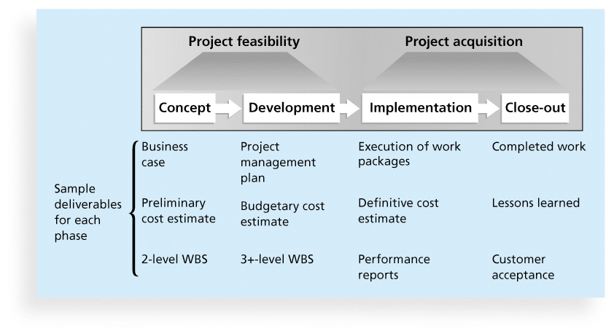
Figure 2-4. Phases of the Traditional Project Life Cycle

Slide 21
Product Life Cycles
Products also have life cycles
The Systems Development Life Cycle (SDLC) is a framework for describing the phases involved in developing and maintaining information systems
Systems development projects can follow
Predictive life cycle: the scope of the project can be clearly articulated and the schedule and cost can be predicted
Adaptive Software Development (ASD) life cycle: requirements cannot be clearly expressed, projects are mission driven and component based, using time-based cycles to meet target dates

Slide 22
Predictive Life Cycle Models
Waterfall model: has well-defined, linear stages of systems development and support
Spiral model: shows that software is developed using an iterative or spiral approach rather than a linear approach
Incremental build model: provides for progressive development of operational software
Prototyping model: used for developing prototypes to clarify user requirements
Rapid Application Development (RAD) model: used to produce systems quickly without sacrificing quality

Slide 23
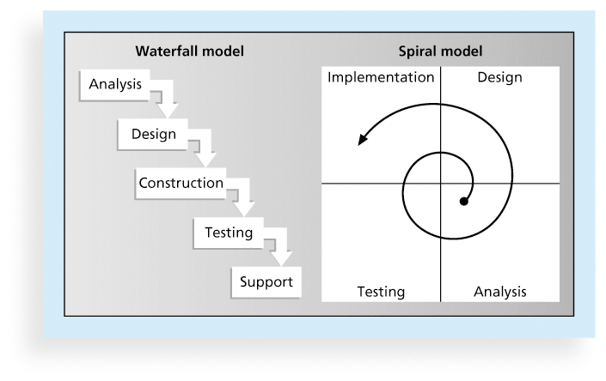
Figure 2-5. Waterfall and Spiral Life Cycle Models

Slide 24
Agile Software Development
Agile software development has become popular to describe new approaches that focus on close collaboration between programming teams and business experts

Slide 25
The Importance of Project Phases and Management Reviews
A project should successfully pass through each of the project phases in order to continue on to the next
Management reviews, also called phase exits or kill points, should occur after each phase to evaluate the project’s progress, likely success, and continued compatibility with organizational goals

Slide 26
The Context of IT Projects
IT projects can be very diverse in terms of size, complexity, products produced, application area, and resource requirements
IT project team members often have diverse backgrounds and skill sets
IT projects use diverse technologies that change rapidly. Even within one technology area, people must be highly specialized

Slide 27
Recent Trends Affecting IT Project Management
Globalization
Outsourcing: Outsourcing is when an organization acquires goods and/or sources from an outside source. Offshoring is sometimes used to describe outsourcing from another country
Virtual teams: A virtual team is a group of individuals who work across time and space using communication technologies
Agile project management

Slide 28
Chapter Summary
Project managers need to take a systems approach when working on projects
Organizations have four different frames: structural, human resources, political, and symbolic
The structure and culture of an organization have strong implications for project managers
Projects should successfully pass through each phase of the project life cycle
Project managers need to consider several factors due to the unique context of information technology projects
Recent trends affecting IT project management include globalization, outsourcing, virtual teams, and Agile

Slide 29
Questions & answers

